Slide 1

Week 13: azure simulations
Notes:
Welcome to Week 12. Today, our focus shifts to applying what we’ve learned about managing cloud risks through interactive, scenario-based discussions. You’ll work in groups on real-world challenges—developing actionable plans to mitigate risks and enhance cloud resilience

Slide 2
review: Week 12
Week 1-2: Introduction to Cloud Technology
Week 3-5: Cloud Strategy and Architecture
Week 6-7: Use Cases and Real-World Applications
Week 8-9: Benefits and Value Proposition
Week 10-12: Challenges and Risks
Week 13-14: Interactive Simulations and Practical Exercises
Week 15: Course Review and Final Assessment
Overview of Activities: Brief rundown of all scenarios
Group Formation: Instructions for team creation and role assignments
Scenario Walkthroughs: Step-by-step instructions for each scenario
Presentation Preparation: Guidelines for presenting your findings
Q&A and Feedback: Final discussion and reflection session
Notes:
In Week 10, we delved into the common pitfalls encountered during cloud adoption. We began by examining how organizations often overestimate cost savings, failing to account for hidden expenses and the intricacies of Azure's pricing models. We then discussed data transfer and integration issues, focusing on the challenges posed by legacy systems and unexpected fees that can disrupt performance. Security and compliance were also major themes, where we identified risks from misconfigurations and emphasized the need for robust monitoring and proper access controls. Additionally, we addressed the critical skills gap, highlighting the importance of continuous training and certifications for effective cloud management. Lastly, we explored vendor lock-in and performance monitoring challenges, underscoring the value of a multi-cloud strategy and centralized monitoring tools. This comprehensive review encapsulates the key areas where careful planning and proactive management are essential to a successful cloud adoption strategy.

Slide 3
agenda
Familiarize with the Azure Portal interface and navigation.
Gain practical experience deploying fundamental Azure services.
Understand the basic configuration options for Virtual Machines, Virtual Networks, and Storage Accounts.
Learn how to monitor resource health and performance.
Appreciate the interconnectedness of Azure services.
Connect hands-on activities to strategic cloud decisions.
Notes:
By the end of this module, our aim is for you to be comfortable navigating the Azure portal and to have personally deployed and configured some of its most basic yet critical services. This includes creating a Web App, Virtual Machine, setting up a Virtual Network to ensure secure communication, and provisioning a Storage Account for data persistence. We will also touch upon the basics of Azure Monitor to see how you can keep an eye on these resources. For you as leaders, the key takeaway will be understanding why certain options are chosen during deployment. For instance, selecting a particular VM size has direct cost and performance implications. Understanding network configurations relates directly to your security posture. And knowing how storage is managed is vital for data governance and disaster recovery. This practical understanding will bridge the gap between high-level strategy and operational execution.

Slide 4
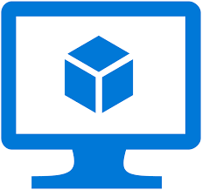
Azure vms
Infrastructure as a Service (IaaS) offering.
On-demand, scalable computing resources.
Supports Linux, Windows Server, SQL Server, Oracle, IBM, SAP, etc.
You manage the OS, applications, and configurations. Azure manages the underlying infrastructure
Notes:
We'll begin our hands-on journey with Azure Virtual Machines, or VMs. VMs are a cornerstone of Infrastructure as a Service (IaaS). Think of them as computers running in Microsoft's datacenters that you can rent and control. This gives you incredible flexibility to run a wide variety of operating systems and applications, just as you would on physical servers in your own data center, but without the overhead of managing the physical hardware. As leaders, understanding VMs is fundamental because they often form the backbone of lift-and-shift migrations or provide the compute power for custom applications. Key considerations for you include: how quickly can a new server be provisioned (agility)? How does the choice of VM size impact monthly costs? How do we ensure these VMs are secure and resilient? This exercise will give you a direct feel for these aspects

Slide 5
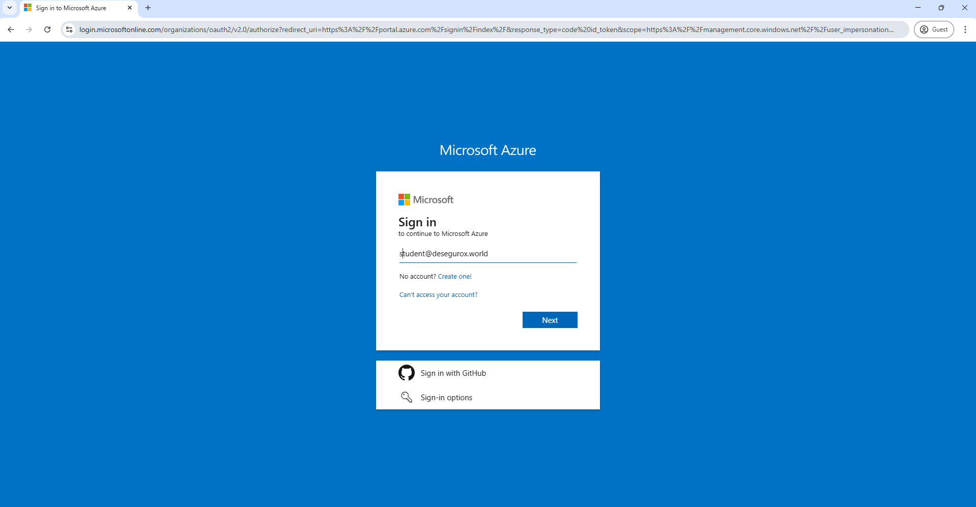
Accessing azure portal
Steps:
Navigate: Open your web browser and go to portal.azure.com.
Sign In: Use the credentials provided.
Notes:
Begin by forming groups of 4 to 6 participants. Assign roles such as facilitator, note-taker, presenter, analyst, and timekeeper so everyone knows their responsibilities. Document your team’s roles on the worksheet provided here on the slide

Slide 6
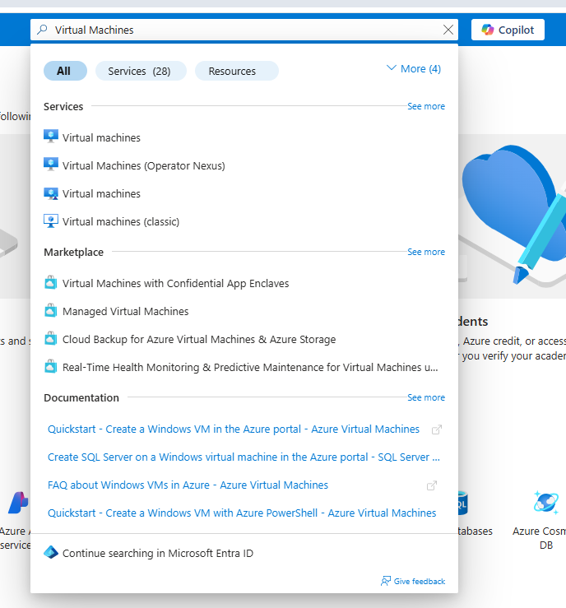
Finding virtual machines service
Search: In the top search bar, type "Virtual machines".
Select: Click on "Virtual machines" under the "Services" category.
Notes:
Once you're logged in, you'll see the Azure dashboard. The easiest way to find any service is to use the search bar at the top. Go ahead and type "Virtual machines" and then select it from the list of services that appears. This will take you to the Virtual Machines management blade.
For Leaders: This demonstrates the user-friendliness and discoverability of services within Azure. For your teams, this means reduced ramp-up time for new engineers. For you, it means that exploring and understanding available services isn't gated by arcane knowledge, but by a fairly intuitive interface. This accessibility can foster innovation as teams can more easily explore new Azure capabilities.

Slide 7
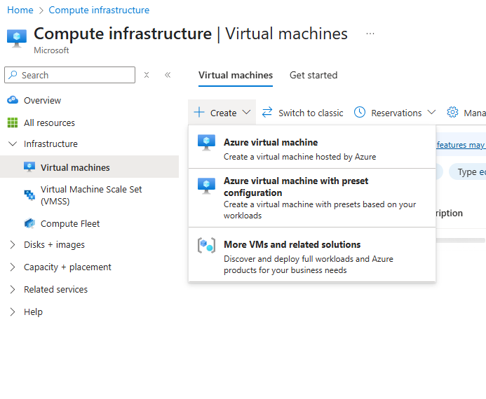
Creating a virtual machine
Steps:
Click Create: On the "Virtual machines" page, click on "+ Create" and then select "Azure virtual machine".
Description: This action starts the VM deployment wizard.
Notes:
Othe Virtual Machines page, you'll see a button, typically labeled "+ Create" or "+ Add". Click this button, and from the dropdown, select "Azure virtual machine". This will launch a multi-tabbed wizard that will guide us through the configuration of our new VM.
For Leaders: Notice the straightforward process to initiate resource creation. This agility is a core cloud benefit – the ability to provision new infrastructure in minutes, not weeks or months. However, this ease of creation also underscores the need for strong governance and cost management, as unmonitored resources can quickly lead to budget overruns.

Slide 8
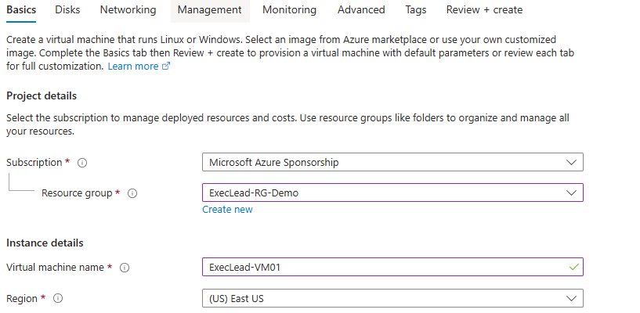
Vm – basics tab
Subscription: Select your assigned Azure subscription. (Usually pre-selected)
Resource Group: Click "Create new", name it ExecLead-RG-Demo. (Or use an existing one if instructed)
Description: Resource Groups are containers for resources that share a common lifecycle, permissions, and policies.
Virtual machine name: Enter ExecLead-VM01.
Region: Select a region (e.g., (US) East US).
Description: The geographical location where your VM will be hosted.
Notes:
On the "Basics" tab, we first define the project and instance details. Your "Subscription" is your billing account with Azure. A "Resource Group" is a fundamental concept in Azure for organizing resources. Think of it as a logical folder. For this demo, let's create a new one: click "Create new" under Resource Group and name it ExecLead-RG-Demo. Then, give your VM a name, like ExecLead-VM01. Finally, select a "Region." This is the physical Microsoft datacenter location where your VM will run.
For Leaders:
Resource Groups: Crucial for cost tracking, management, and applying policies. Insist your teams use them logically (e.g., per project, per environment).
Region: This choice impacts latency for your users, data sovereignty (compliance), service availability, and cost. A strategic decision!

Slide 9
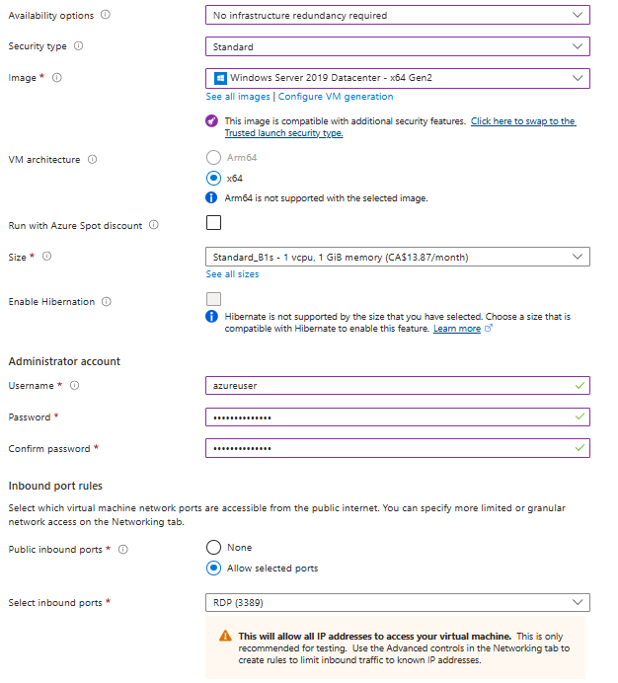
Vm – basics tab: image, size, admin account
Availability options: Leave as "No infrastructure redundancy required" for this demo.
Image: Select "Windows Server 2019 Datacenter - Gen2".
Description: The operating system template for your VM.
Size: Select a size (e.g., Standard_B1s - 1 vCPU, 1 GiB memory).
Description: Defines CPU, RAM, and storage performance of the VM. Directly impacts cost.
Administrator account:
Username: azureuser
Password: Create a complex password (e.g., P@$$wOrd12345!) and confirm it. Remember this!
Inbound port rules: Select "Allow selected ports". Then check "RDP (3389)".
Description: Allows Remote Desktop Protocol connections for Windows VMs.
Notes:
Continuing on the Basics tab: "Availability options" relate to high availability and disaster recovery, which we'll discuss later; for now, the default is fine. For "Image," choose "Windows Server 2019 Datacenter - Gen2." This is our OS. For "Size," click "See all sizes" to understand the options, but for today, a small, cost-effective size like Standard_B1s is sufficient. This choice heavily influences cost and performance. Then, set up an administrator account: username azureuser and a strong password that you'll remember – we'll need it to log in. Finally, for "Inbound port rules," ensure "RDP (3389)" is allowed so we can connect to our Windows VM.
For Leaders:
Image: Choice of OS. Licensing costs can be a factor here (some images include licenses).
Size: One of the biggest cost drivers. Over-provisioning is a common source of wasted cloud spend. Right-sizing is key.
Admin Account & Ports: Security fundamentals. Strong passwords and principle of least privilege for port access are critical. Allowing RDP from anywhere on the internet is fine for a demo, but a huge security risk in production (should be restricted to specific IPs or use Bastion).

Slide 10
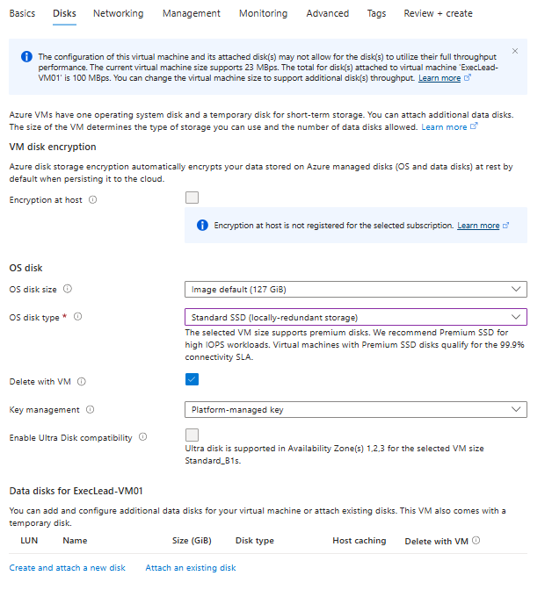
Vm – disks tab
OS disk type: Select Standard SSD for a balance of cost and performance.
Description: Options include Standard HDD, Standard SSD, Premium SSD. Affects performance and cost.
Leave other settings as default for this demo.
Notes:
Next, click on the "Disks" tab. Here, you configure the operating system disk and any additional data disks. The "OS disk type" is important. Premium SSDs offer the best performance but are more expensive. Standard SSDs provide a good balance, and Standard HDDs are the cheapest but slowest. For our demo, Standard SSD is fine. We won't add extra data disks today. For Leaders: Disk type and size directly impact application performance and cost. Applications with high I/O (input/output) needs will require Premium SSDs. Understanding these choices helps in budgeting and performance planning. Data resiliency options (disk redundancy) are also configured here, impacting your DR strategy.

Slide 11
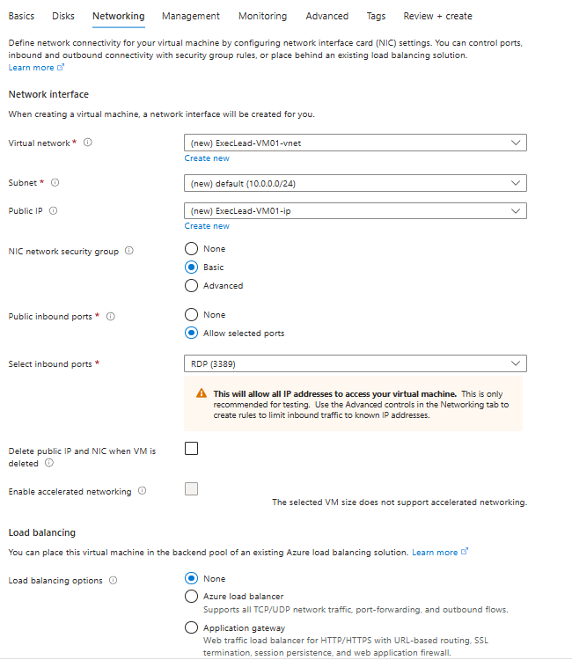
Vm – networking tab
Virtual network: A new VNet will be created by default based on your resource group name (e.g., ExecLead-RG-Demo-vnet). This is fine for the demo.
Subnet: A default subnet will also be created.
Public IP: A new Public IP will be created. This allows connection from the internet.
NIC network security group: Select Basic.
Public inbound ports: Confirm "Allow selected ports" is chosen and "RDP (3389)" is checked.
Notes:
Now, let's look at the "Networking" tab. This is where we define how our VM connects to other resources and the internet. By default, Azure will propose creating a new Virtual Network (VNet), Subnet, and Public IP address for you. For this initial demo, these defaults are acceptable. The Network Security Group (NSG) acts as a firewall; the "Basic" option with RDP port 3389 allowed (which we set on the Basics tab) is what we need.
For Leaders: Networking is a critical security and architecture consideration.
VNet Design: Proper VNet and subnet design is essential for isolation, security, and scalability.
Public IPs: Exposing VMs directly to the internet with Public IPs increases risk. In production, you'd often use services like Azure Bastion or VPNs for access.
NSGs: Your first line of defense for network traffic. Ensure your teams have robust NSG rules.

Slide 12
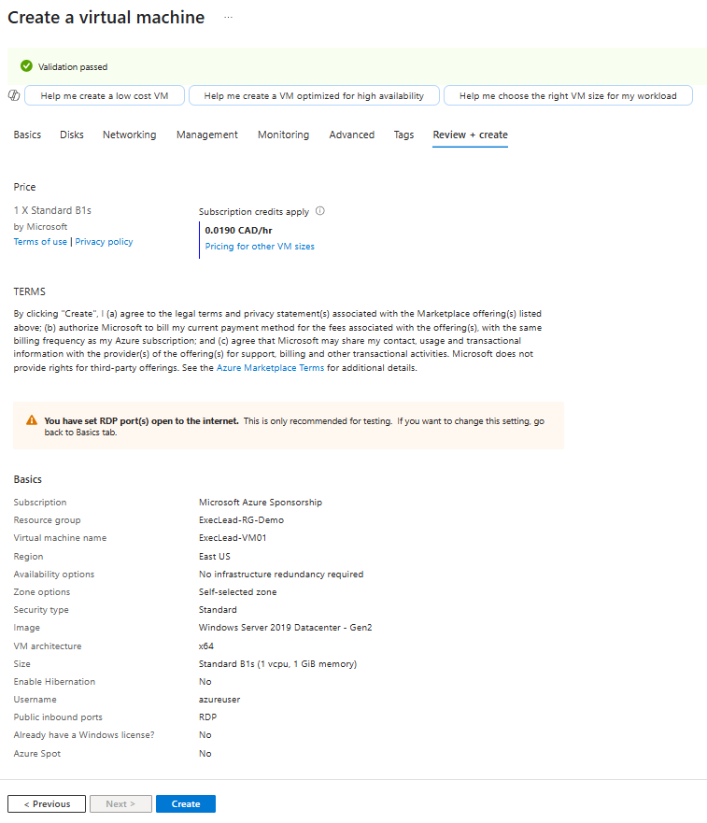
Vm – review + create
Review Settings: Azure will validate your configuration. If it passes, you'll see "Validation passed". Review the summary to ensure settings are as expected.
Create: Click the "Create" button at the bottom.
Notes:
Azure checks for configuration errors before deployment. The deployment process may take a few minutes.
We'll skip the "Management," "Advanced," and "Tags" tabs for this basic deployment. Click "Review + create." Azure performs a final validation of your settings. If everything is correct, you'll see a "Validation passed" message. Take a moment to review the summary of your VM configuration – this is your last chance to go back and change anything. Once you're satisfied, click "Create."
For Leaders: The validation step is important; it catches common errors. The "Tags" tab (which we skipped) is crucial for cost tracking and resource organization in larger environments – ensure your teams are using tags effectively. The deployment will now begin and might take 5-10 minutes. This is a good time to reflect on how much faster this is than procuring and racking a physical server.

Slide 13
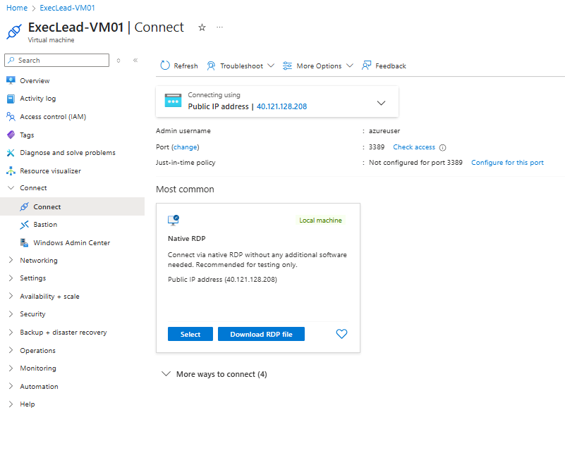
Vm – deployment & connection
Monitor Deployment: You'll be taken to a deployment screen. Wait for it to complete ("Your deployment is complete").
Go to Resource: Click "Go to resource".
Connect: On the VM's "Overview" page, click "Connect" and select "RDP".
Download RDP File: Download the RDP file.
Open RDP File: Run the downloaded file, click "Connect", and enter the administrator credentials you created (e.g., azureuser and P@$$wOrd12345!).
Notes:
You can monitor the deployment progress. Once it says "Your deployment is complete," click the "Go to resource" button. This takes you to the overview page for your newly created VM. To connect to it, click the "Connect" button at the top, choose "RDP," and download the RDP file. Open this file, and when prompted, use the username azureuser (you might need to choose "More choices" then "Use a different account" and enter it as .\azureuser or machinename\azureuser) and the password you set earlier. You should then see the Windows Server desktop!
For Leaders: Witnessing the full deployment and connection cycle provides a concrete understanding of IaaS. The ability to remotely access and manage this server from anywhere highlights cloud flexibility. Security of RDP access is paramount; in production, this would be more tightly controlled (e.g., Azure Bastion, JIT Access, VPN).

Slide 14

Azure virtual networks (vnets)
Your private network in Azure.
Enables Azure resources to securely communicate with each other, the internet, and on-premises networks.
Provides isolation, segmentation (subnets), routing, and filtering (NSGs).
Fundamental for network architecture and security.
Notes:
We briefly touched on Virtual Networks (VNets) when creating our VM, as Azure created one for us. Now, let's look at them more deliberately. An Azure VNet is essentially your own isolated network within the Azure cloud. It allows your Azure resources, like VMs, to communicate securely with each other. You can also connect VNets to the internet or even to your on-premises datacenters.
For Leaders: VNets are the bedrock of your Azure network security and architecture. Proper VNet design, including IP addressing schemes, subnets for segmentation (e.g., web tier, app tier, data tier), and Network Security Groups (NSGs) for traffic filtering, is critical for a secure and scalable cloud environment. Decisions made here have long-term implications for security, connectivity, and compliance.

Slide 15
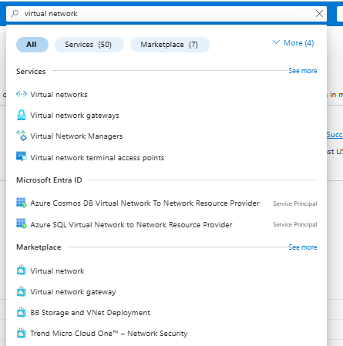
Finding the vnet service
Navigate: In the Azure Portal search bar, type "Virtual networks".
Select: Click on "Virtual networks" under "Services".
Notes:
Let's create a new Virtual Network from scratch to better understand the process. Just like before, use the search bar at the top of the Azure Portal, type "Virtual networks," and select it from the services list. This will take you to the Virtual Networks management blade.
For Leaders: While your VM automatically created a VNet, understanding how to create one independently shows the modularity of Azure services. This allows for more deliberate network planning before deploying compute resources, which is best practice for complex environments.

Slide 16
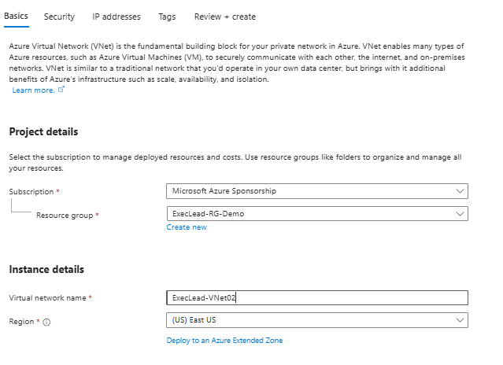
creating the vnet service
Click "+ Create".
Subscription: Select your subscription.
Resource Group: Select the ExecLead-RG-Demo Resource Group we created earlier.
Name: Enter ExecLead-VNet02.
Region: Select the same region as your VM (e.g., (US) East US).
Notes:
On the Virtual Networks page, click "+ Create." On the "Basics" tab, select your subscription and the ExecLead-RG-Demo Resource Group we used for our VM. Let's name this new VNet ExecLead-VNet02 and ensure it's in the same region as our VM, for example, (US) East US.
For Leaders: Consistency in resource grouping and region selection is important for management and potential performance/cost implications if resources that need to communicate frequently are in different regions. Centralized network management within a consistent RG simplifies oversight.

Slide 17
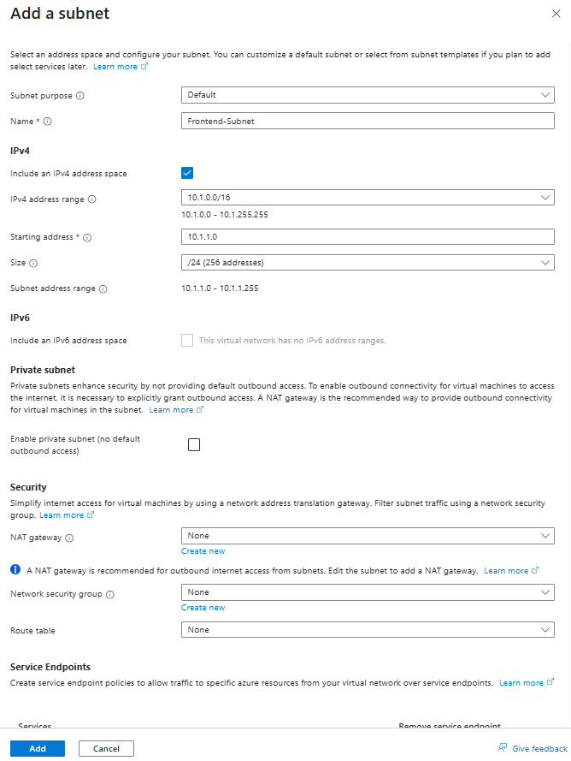
Defining ip addresses
IPv4 address space: Enter 10.1.0.0/16.
Description: The overall private IP range for this VNet. /16 provides ~65,000 addresses.
Subnets:
Click "+ Add subnet".
Subnet name: Frontend-Subnet
Subnet address range: 10.1.1.0/24 (/24 provides ~250 addresses)
Click "Add".
(Optional) Add another subnet: Backend-Subnet with range 10.1.2.0/24.
Notes:
Next, click the "IP Addresses" tab. This is where you define the private IP address space for your VNet. For the "IPv4 address space," let's use 10.1.0.0/16. This CIDR block gives us a large pool of addresses. Within a VNet, we create subnets. Click "+ Add subnet." Name the first one Frontend-Subnet and give it an address range like 10.1.1.0/24. This carves out a smaller portion of our VNet's address space. Click "Add." You could optionally add more subnets, like one for backend services.
For Leaders: IP address planning is critical. Ensure your teams plan this carefully to avoid overlaps if you connect to on-premises networks or other VNets (VNet peering). Subnetting is key for security segmentation – isolating different application tiers (web, app, database) into different subnets allows you to apply specific firewall rules (NSGs) to each, enhancing security.

Slide 18
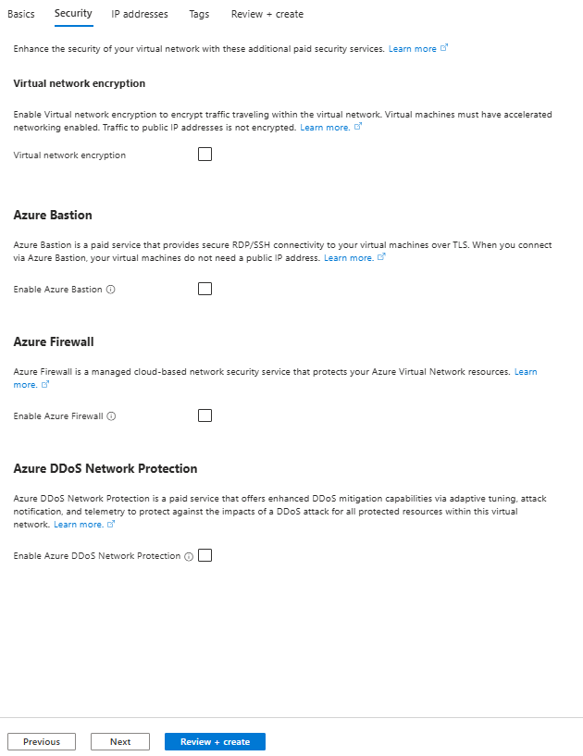
Review + create virtual network
Security Tab (Optional): Briefly show the options for BastionHost, DDoS Protection, Firewall. We will NOT enable these for this demo to keep it simple and control costs.
Description: These are advanced security services.
Click "Review + create".
Validation: Wait for "Validation passed".
Click "Create"
Notes:
Next, click the "IP Addresses" tab. This is where you define the private IP address space for your VNet. For the "IPv4 address space," let's use 10.1.0.0/16. This CIDR block gives us a large pool of addresses. Within a VNet, we create subnets. Click "+ Add subnet." Name the first one Frontend-Subnet and give it an address range like 10.1.1.0/24. This carves out a smaller portion of our VNet's address space. Click "Add." You could optionally add more subnets, like one for backend services.
For Leaders: IP address planning is critical. Ensure your teams plan this carefully to avoid overlaps if you connect to on-premises networks or other VNets (VNet peering). Subnetting is key for security segmentation – isolating different application tiers (web, app, database) into different subnets allows you to apply specific firewall rules (NSGs) to each, enhancing security.

Slide 19
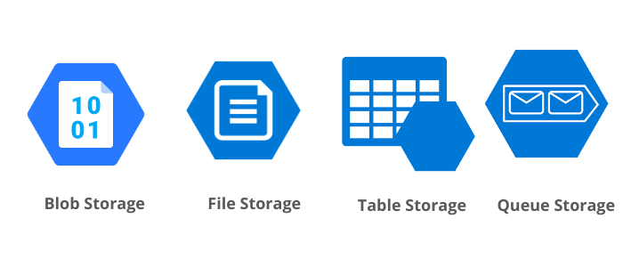
Azure storage accounts
Provides scalable, secure, and highly available cloud storage.
Supports various data types:
Blobs: Object storage for unstructured data (documents, videos, backups).
Files: Managed file shares (SMB protocol).
Queues: Messaging for decoupling applications.
Tables: NoSQL key-value store.
Multiple redundancy options (LRS, GRS, RA-GRS, ZRS).
Notes:
Next, we'll explore Azure Storage Accounts. A storage account is a container that groups a set of Azure Storage services together. It provides a unique namespace for your data. Azure Storage offers different types of services to cater to various needs: Blob storage for unstructured objects like documents or media files, Azure Files for traditional file shares, Queues for messaging, and Tables for NoSQL data.
For Leaders: Storage is a fundamental component of any IT solution. Key considerations for you:
Cost: Storage costs vary significantly based on type, redundancy, and access tiers (hot, cool, archive for blobs).
Data Durability/Redundancy: Options like LRS (Locally Redundant), GRS (Geo-Redundant), ZRS (Zone-Redundant) impact data protection and availability – align this with your RPO/RTO.
Security: Access control, encryption at rest, and network security for storage are paramount.

Slide 20
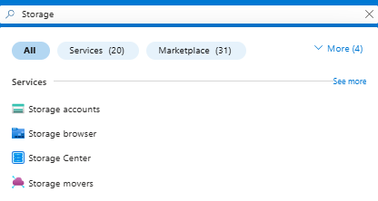
Finding the storage account service
Steps:
Navigate: In the Azure Portal search bar, type "Storage accounts".
Select: Click on "Storage accounts" under "Services".
Notes:
Let's create a Storage Account. In the Azure portal search bar, type "Storage accounts" and select it from the services list. This takes you to the Storage Accounts management blade. Then click on “Create” For Leaders: Understanding the types of storage available and their use cases helps in strategic discussions about data management, application architecture, and cost optimization. This simple step shows how easily diverse storage capabilities can be accessed.

Slide 21
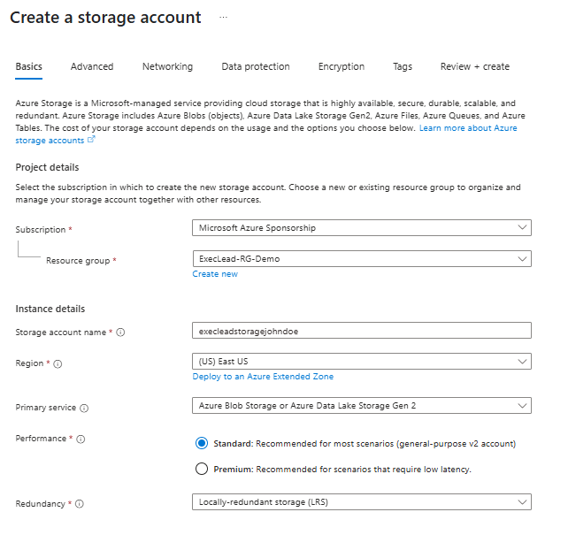
Storage account – basics tab
Click "+ Create".
Subscription: Select your subscription.
Resource Group: Select ExecLead-RG-Demo.
Storage account name: Enter a globally unique name (lowercase letters and numbers only, e.g., execleadstorage + your initials + random numbers like execleadstoragejohndoe123).
Region: Select the same region (e.g., (US) East US).
Performance: Select Standard. (Premium is for low-latency workloads like VM disks).
Redundancy: Select Locally-redundant storage (LRS).
Description: Lowest cost, protects against disk/node failure within one datacenter.
Notes:
On the Storage Accounts page, click "+ Create." On the "Basics" tab: select your subscription and the ExecLead-RG-Demo Resource Group. For the "Storage account name," this needs to be globally unique across all of Azure, using only lowercase letters and numbers. So, try something like execleadstorage followed by your initials and some random numbers. Select the same Region. For "Performance," Standard is fine for general-purpose use. "Redundancy" is a key choice: Locally-redundant storage (LRS) is the cheapest, with 3 copies within a single datacenter. Other options offer more resilience across zones or regions but cost more.
For Leaders:
Naming Convention: The global uniqueness requirement highlights Azure's scale. Good naming conventions are vital for your organization.
Performance (Standard vs. Premium): Impacts cost and speed. Standard is for bulk storage, files, queues. Premium is for high-IOPS VM disks or specific blob scenarios.
Redundancy: This is a critical decision aligning with your business continuity and disaster recovery (BCDR) strategy. LRS is fine for dev/test, but production often needs GRS (Geo-Redundant Storage) or ZRS (Zone-Redundant Storage). This directly impacts data durability and cost.

Slide 22
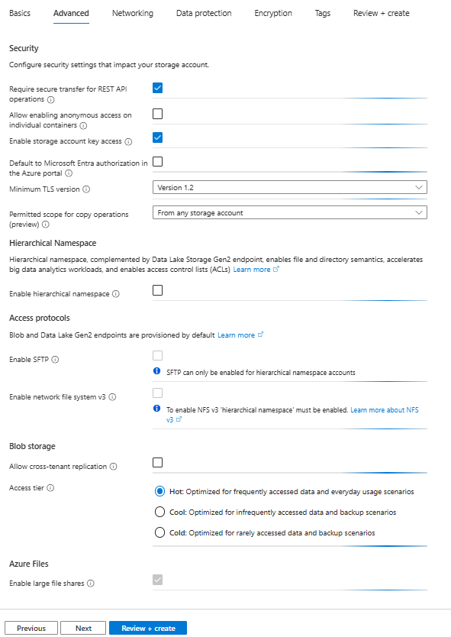
Storage account – advanced + review tab
Advanced Tab (Optional): Briefly show "Blob access tier (default)" is Hot.
Description: Hot tier for frequently accessed data. Cool/Archive for less frequent, lower cost.
Skip "Networking", "Data protection", "Encryption", "Tags" for this basic demo.
Click "Review + create".
Validation: Wait for "Validation passed".
Click "Create".
Notes:
On the "Advanced" tab, notice the "Blob access tier" is set to Hot by default. This is for frequently accessed data. Cool and Archive tiers offer lower storage costs for data accessed less often but have higher access costs. We'll skip the other tabs for now, which cover networking rules, data protection features like soft delete, and encryption key management. Click "Review + create," wait for validation, and then click "Create.“
For Leaders:
Access Tiers (Hot/Cool/Archive): A significant cost optimization lever for Blob storage. Implementing data lifecycle management to move data to cooler tiers can save substantial money.
Skipped Tabs (Networking, Data Protection, Encryption): In a real-world scenario, these are critical.
Networking: Defining if the storage account is accessible from all networks or restricted to specific VNets (using private endpoints).
Data Protection: Features like soft delete, versioning, point-in-time restore.
Encryption: Azure encrypts data at rest by default with Microsoft-managed keys, but you can use customer-managed keys for more control.

Slide 23
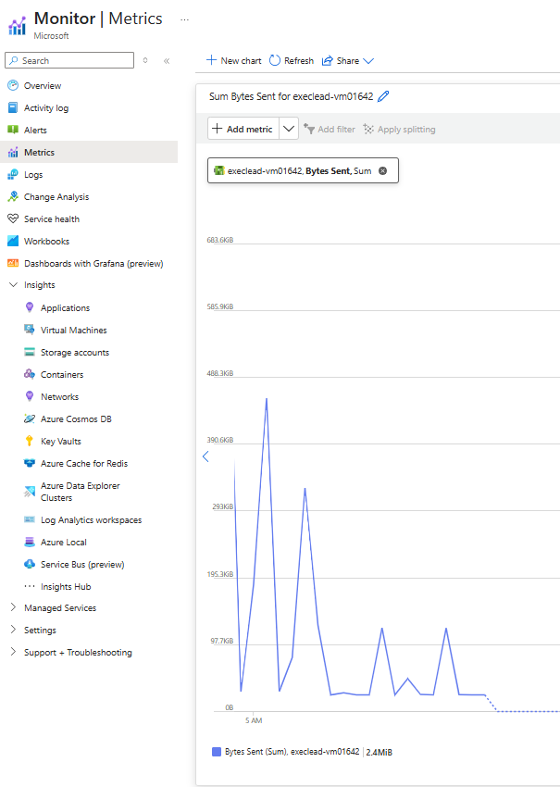
Azure monitor
Comprehensive monitoring solution for Azure resources and hybrid environments.
Collects, analyzes, and acts on telemetry data.
Key capabilities:
Metrics: Numerical performance data.
Logs: Activity logs, diagnostic logs, application logs.
Alerts: Proactive notifications for critical conditions.
Dashboards & Workbooks: Visualization of data.
Insights: Curated monitoring experiences for specific services.
Notes:
Once you have resources deployed, monitoring them is crucial. Azure Monitor is Azure's built-in platform service for collecting, analyzing, and acting on telemetry from your cloud and on-premises environments. It helps you understand how your applications are performing and identify issues affecting them. It works with metrics (performance counters), logs (events and traces), and allows you to set up alerts for proactive notification.
For Leaders: Azure Monitor is your eyes and ears in the cloud. It's essential for:
Operational Excellence: Ensuring services are running optimally.
Cost Management: Identifying underutilized resources or unexpected spikes in usage.
Security: Detecting suspicious activities through activity logs and security alerts (via Microsoft Defender for Cloud integration).
Performance Insights: Understanding application bottlenecks. Ensure your teams are leveraging Azure Monitor effectively.

Slide 24
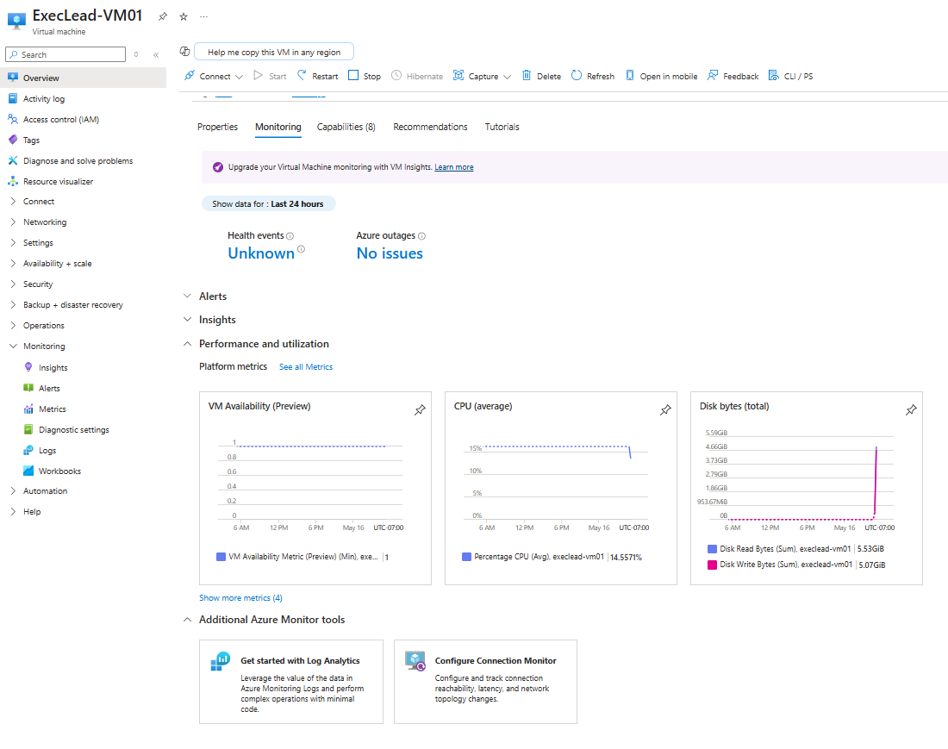
Exploring vm metrics
Overview Page: The VM's "Overview" page by default shows some key metrics like CPU, Network, Disk.
Metrics Blade: For more detail, in the left-hand menu for the VM, scroll down to the "Monitoring" section and click on "Metrics".
Add Metric: Select a metric like Percentage CPU. Observe the chart.
Add more metrics: Try adding Network In Total or Disk Read Bytes.
Notes:
The "Overview" page of the VM already shows some pre-configured charts for key metrics like CPU utilization, network traffic, and disk operations. For more detailed analysis, find the "Monitoring" section in the left-hand navigation pane for your VM and click on "Metrics." Here, you can build custom charts. For example, select Percentage CPU as the metric. You can add multiple metrics to the same chart or create new charts. Try adding Network In Total to see network traffic.
For Leaders: These charts provide a direct view into resource health and utilization.
Capacity Planning: Consistently high CPU or memory usage might indicate a need for a larger VM (scale-up) or more VMs (scale-out).
Cost Optimization: Consistently low utilization might mean the VM is oversized and you're paying for capacity you don't need.
Troubleshooting: Performance metrics are the first place to look when users report slowness.

Slide 25
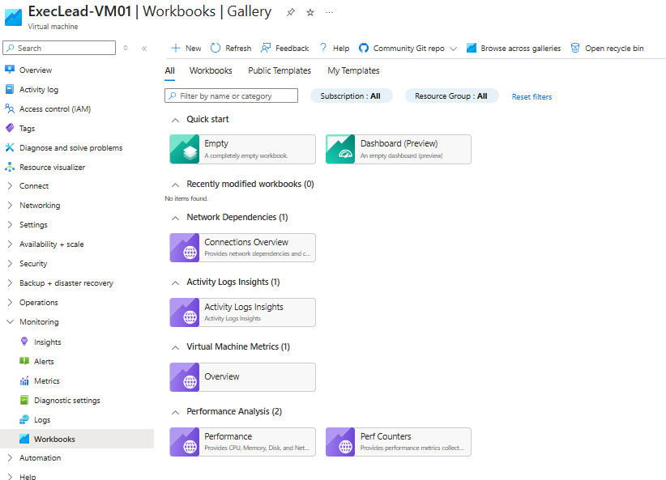
Exploring vm metrics – activity log
Navigate: In the left-hand menu for the VM, under "Monitoring" (or sometimes higher up), click on “Workbooks” then select "Activity log Insights".
Review Events: Observe the list of operations performed on this VM (e.g., Create, Start, Update).
The Activity Log shows all control-plane operations performed on a resource. It's an audit trail.
Notes:
Another important monitoring tool is the "Activity log." Still within your VM's management blade, find "Activity log" in the left navigation (it's usually near the top or under Monitoring). This log provides an audit trail of all subscription-level events that have impacted this resource, such as when it was created, started, stopped, or updated, and who performed the action.
For Leaders: The Activity Log is crucial for:
Auditing & Compliance: Who did what, and when? This is essential for security reviews and meeting compliance requirements.
Troubleshooting: If a resource suddenly misbehaves, the Activity Log can show if any recent changes were made that might be the cause.
Change Management: Tracking changes to critical resources.
NOTE: It takes a few hours for logs to show activity on a newly created VM

Slide 26
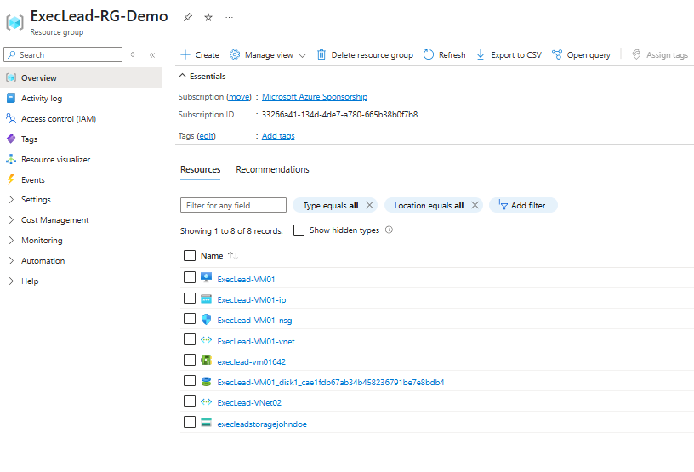
Managing resource groups
All resources we created (ExecLead-VM01, ExecLead-VNet02, execleadstorage..., NICs, IPs, Disks) are in ExecLead-RG-Demo.
Logical container for grouping related resources for an application or project.
Simplifies management, billing, and access control.
Deleting a Resource Group deletes all resources within it.
Notes:
Let's revisit Resource Groups. Navigate to "Resource groups" in the portal and open ExecLead-RG-Demo. You'll see all the resources we've created today – the VM, its disk, its network interface, its public IP, the VNet, and the storage account – are all neatly organized here. Resource Groups are not just folders; they are a fundamental unit of management. You can apply policies and role-based access control (RBAC) at the Resource Group level, and these permissions will be inherited by the resources within. Most importantly for cleanup or decommissioning, deleting a Resource Group deletes all resources it contains. This is incredibly useful for managing the lifecycle of applications or projects.
For Leaders: Resource Groups are a cornerstone of good Azure governance.
Cost Management: Costs can be easily tracked and reported per Resource Group.
Lifecycle Management: Simplifies deploying, managing, and retiring entire applications or environments.
Access Control: Granular control over who can do what to a set of related resources. Mandate a clear Resource Group strategy in your organization.

Slide 27
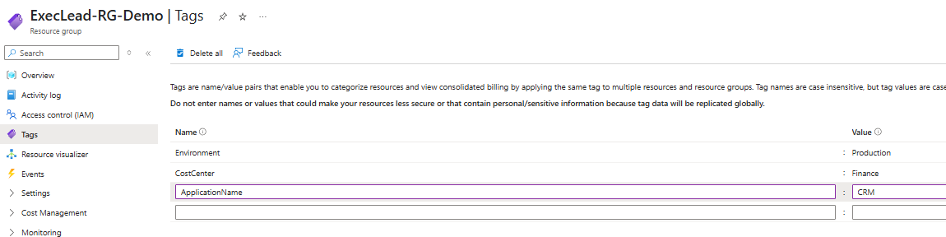
Managing resources: tagging
Tags are key/value pairs applied to Azure resources.
Used for:
Organizing resources across Resource Groups.
Cost tracking and billing reports (filter by tag).
Automation (scripts can act on tagged resources).
Applying policies.
Example: Environment:Production, Owner:jane.doe@company.com, Project:Alpha.
Notes:
While we didn't apply tags during creation to save time, "Tags" are another critical management feature. You can find the "Tags" option in the left navigation for any resource or Resource Group. Tags are simply key-value pairs that you define and apply to your resources. For example, you might tag resources with Environment:Production, CostCenter:Finance, or ApplicationName:CRM. These tags then allow you to categorize resources for billing, automate management tasks, or apply specific governance policies. For instance, you could generate a cost report filtered by a specific CostCenter tag.
For Leaders: Tagging is non-negotiable for effective cloud financial operations (FinOps) and governance.
Cost Allocation: Essential for accurately attributing cloud costs to different departments, projects, or initiatives.
Resource Management: Helps identify resource owners, application affiliations, and operational status.
Policy Enforcement: Azure Policy can enforce tagging standards (e.g., require an Owner tag on all VMs). Establish and enforce a comprehensive tagging strategy early in your cloud adoption journey.

Slide 28
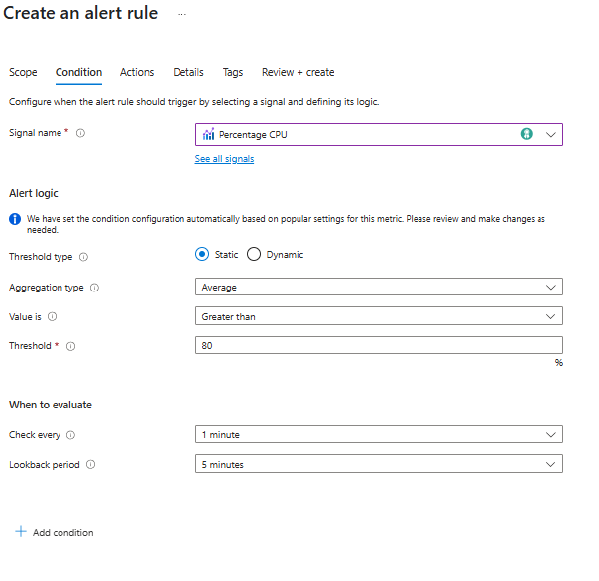
Setting up a basic alert (conceptual)
Azure Monitor allows proactive alerting.
Condition: Define a threshold (e.g., CPU > 80% for 5 mins).
Action Group: Define what happens when the alert fires (e.g., send an email, SMS, trigger an Azure Function).
Navigate to Azure Monitor -> Alerts -> + Create alert rule.
Select a resource (e.g., your VM), define condition, create/select action group.
Description: Alerts notify you of important conditions, enabling quick response.
Notes:
While we won't configure a live alert in this brief hands-on session due to time, it's crucial to understand this capability. Azure Monitor allows you to create alerts that proactively notify you when specific conditions are met. For example, you could set an alert to trigger if a VM's CPU utilization exceeds 80% for more than 5 minutes. When an alert fires, it can trigger an "Action Group," which could send an email to administrators, a text message, or even execute an automated script (like an Azure Function) to attempt remediation. You would typically go to Azure Monitor, select "Alerts," and then create a new alert rule, specifying the target resource, the condition to monitor, and the action group.
For Leaders: Alerts are vital for maintaining service uptime and performance.
Proactive Issue Detection: Get notified of problems before your users are significantly impacted.
Automation: Enables automated responses to common issues, reducing manual intervention.
SLA Adherence: Helps ensure you're meeting service level agreements. Your operations teams should have a robust alerting strategy covering key performance indicators (KPIs) and critical failure conditions.

Slide 29
In the simulation, RDP port 3389 was opened to "Any" source for the Windows VM. From a leadership perspective overseeing a production environment, what is the most significant risk associated with this configuration that you would want your team to mitigate?
A. Increased data egress costs due to RDP traffic. B. High exposure to internet-based brute-force attacks and potential unauthorized access. C. The VM will not be able to communicate with other services in its Virtual Network. D. It prevents the use of Azure Monitor for tracking VM performance.

Slide 30
In the simulation, RDP port 3389 was opened to "Any" source for the Windows VM. From a leadership perspective overseeing a production environment, what is the most significant risk associated with this configuration that you would want your team to mitigate?
A. Increased data egress costs due to RDP traffic. B. High exposure to internet-based brute-force attacks and potential unauthorized access. C. The VM will not be able to communicate with other services in its Virtual Network. D. It prevents the use of Azure Monitor for tracking VM performance.
Notes:
Correct Answer: B Rationale for Leaders: Security is paramount. Exposing RDP to the entire internet is a major security vulnerability. A is minor, C is incorrect (RDP is for inbound access), and D is incorrect. Leaders must ensure security best practices are followed.

Slide 31
The course outline emphasizes the importance of tagging resources (e.g., Environment:Training, CostCenter:ITDept), even though it was briefly mentioned in the simulation. From a leadership perspective responsible for cloud spend, what is the most significant benefit of implementing a consistent tagging strategy?
Tags enable accurate cost allocation, improved financial reporting, and showback/chargeback to departments.
B. Tags automatically apply security patches to tagged resources. C. Tags significantly increase the performance of the tagged resources. D. Tags are required for resources to communicate with each other across different regions

Slide 32
The course outline emphasizes the importance of tagging resources (e.g., Environment:Training, CostCenter:ITDept), even though it was briefly mentioned in the simulation. From a leadership perspective responsible for cloud spend, what is the most significant benefit of implementing a consistent tagging strategy?
Tags enable accurate cost allocation, improved financial reporting, and showback/chargeback to departments.
B. Tags automatically apply security patches to tagged resources. C. Tags significantly increase the performance of the tagged resources. D. Tags are required for resources to communicate with each other across different regions
Notes:
Correct Answer: A Rationale for Leaders: FinOps (Cloud Financial Operations) is a key leadership concern. Tagging is essential for understanding and managing cloud costs effectively. A, C, and D are incorrect.

Slide 33
The simulation involved creating all resources (VM, VNet, Storage Account) within a single Resource Group named ExecLead-RG-Demo. What is the primary strategic advantage of this approach for managing the lifecycle of these temporary demo resources?
A. It automatically load balances traffic across the resources within the group. B. It simplifies the process of deleting all associated demo resources simultaneously, preventing orphaned resources and costs. C. It provides enhanced network isolation by default between the resources in the group. D. It reduces the individual cost of each resource when grouped together.

Slide 34
The simulation involved creating all resources (VM, VNet, Storage Account) within a single Resource Group named ExecLead-RG-Demo. What is the primary strategic advantage of this approach for managing the lifecycle of these temporary demo resources?
A. It automatically load balances traffic across the resources within the group. B. It simplifies the process of deleting all associated demo resources simultaneously, preventing orphaned resources and costs. C. It provides enhanced network isolation by default between the resources in the group. D. It reduces the individual cost of each resource when grouped together.
Notes:
Correct Answer: B Rationale for Leaders: Resource Groups are key for lifecycle management. For demos or projects, grouping allows for easy cleanup, which is crucial for cost control and avoiding sprawl. A, C, and D are incorrect descriptions of Resource Group functionality.

Slide 35

reflection
Task: Individually write down one key insight from today’s session
Focus: Reflect on how integrated risk management can be applied in your role
Discussion: Share your insight with a partner or small group
Documentation: Record your reflection in your personal action plan worksheet
Outcome: Strengthen your personal commitment to continuous improvement
Notes:
Take a few minutes to reflect individually on what you learned today. Write down one key insight and think about how you can apply it in your role. Share your thoughts with a partner, and record your reflection on your personal action plan worksheet.

Slide 36
COURSE review
Tangible Understanding: Gained a feel for how cloud resources are provisioned and configured.
Strategic Implications of Choices: VM size, region, storage redundancy, network design – all have cost, performance, and security impacts.
Agility & Speed: Witnessed how quickly infrastructure can be deployed.
Importance of Governance: Resource Groups, Tagging, and RBAC are essential for control and cost management.
Monitoring is Key: Azure Monitor provides visibility for operational excellence, security, and cost optimization.
Security is Pervasive: Security considerations (NSGs, RDP access, Bastion, Firewalls) are present at every step.
Week 1-2: Introduction to Cloud Technology
Week 3-5: Cloud Strategy and Architecture
Week 6-7: Use Cases and Real-World Applications
Week 8-9: Benefits and Value Proposition
Week 10-12: Challenges and Risks
Week 13-14: Interactive Simulations and Practical Exercises
Week 15: Course Review and Final Assessment

Slide 37
Next week: simulations
Next week, we shift from the whiteboard to the Azure Portal with guided hands-on labs. You’ll deploy core Azure services like virtual machines and web apps—not just to click buttons, but to understand the architecture and rationale behind each configuration. We’ll walk through virtual networking and storage account setups, focusing on best practices for both security and performance.
Then we’ll introduce Azure Monitor and related tools to help you track costs, usage, and performance in real time. For governance, we’ll touch on resource policies—how organizations can enforce rules at scale.

Slide 38

Q&A and open discussion

Slide 39

Kiali distributed tracing (Jaeger)

